Slide 1
Dynamics of
Global Happiness
Data and Discoveries from the World Happiness Report
Group 1: Claven, Kang You, Shao Yang

Slide 2
Table of contents
01
02
03
04
05
06
Practical Motivation & Sample Collection
Problem Formulation &
Data Preparation
Statistical Description & Exploratory Analysis
Machine Learning
Analytic Visualization & Pattern Recognition
Conclusion & What did we learn

Slide 3

01
Practical Motivation & Sample Collection

Slide 4

Real-life Problem
Difficult for governments to make informed policy decisions:
Hard to determine which factors strongly influence happiness scores and human development indexes
How much resources and time should be invested in designing certain policies?

Slide 5

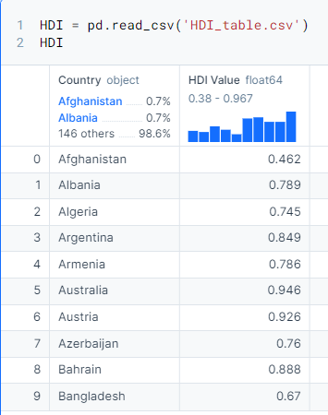
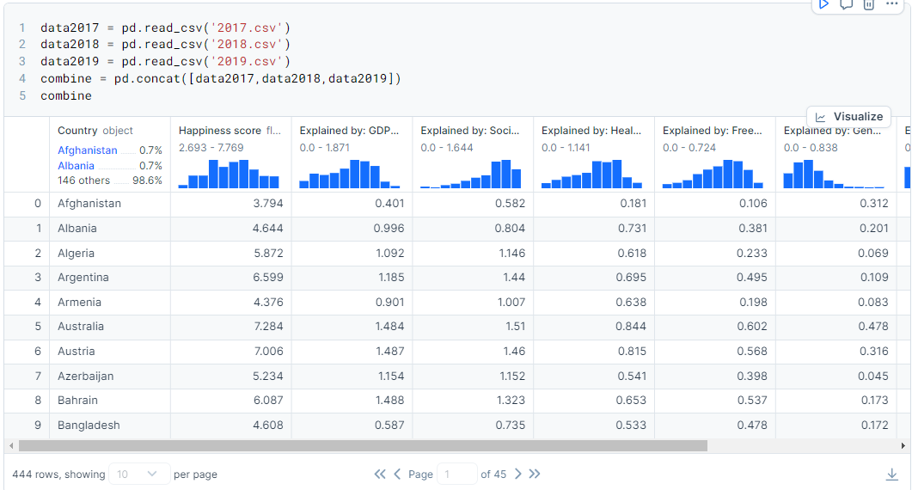
Sample Collection
Dataset obtained from Kaggle
Obtained from the HDR website
https://hdr.undp.org/data-center/human-development-index#/indicies/HDI
https://www.kaggle.com/datasets/unsdsn/world-happiness/data

Slide 6

02
Problem Formulation &
Data Preparation

Slide 7
Real-life Problem
Difficult for governments to make informed policy decisions:
Hard to determine which factors strongly influence happiness scores and human development indexes
How much resources and time should be invested in designing certain policies?
Problem Formulation
Problem Statement:
To utilize machine learning models to determine which factors are most predictive of happiness scores and whether there is any correlation between happiness scores and the human development index.

Slide 8


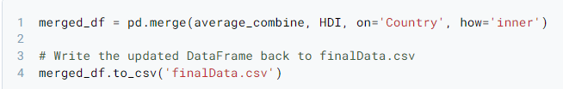
Data Preparation & Cleaning
Merging 3 dataframes (2017, 2018, 2019) into one
Merged HDI Value column into our existing data sheet, outputting it into a final data file
Additional Changes
Renaming columns | 'Family' column in 2017.csv -> 'Social Support'
Deleted countries | Deleted numerous countries from 2018.csv and 2019.csv, using 2017.csv as a reference
Reordering columns | Reordering the columns in all csv files to make sure they follow the same order

Slide 9

03
Statistical Description & Exploratory Analysis

Slide 10
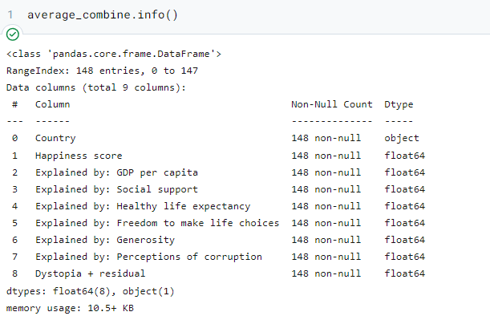
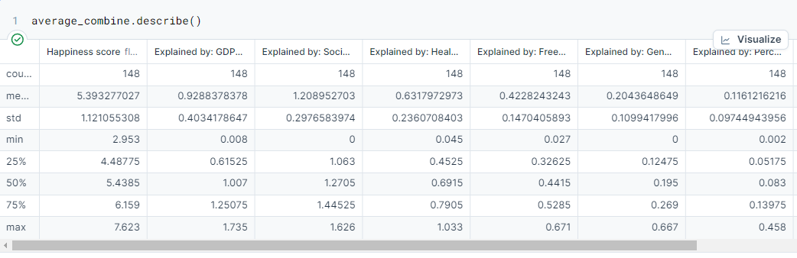
Preliminary Exploration
First explored the data by finding out the data types, null count, etc. of variables that will be used as predictors and response
Finding key statistical variables such as mean, standard deviation, quartiles, etc.

Slide 11

04
Analytic Visualization & Pattern Recognition

Slide 12
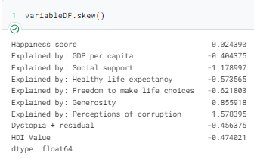
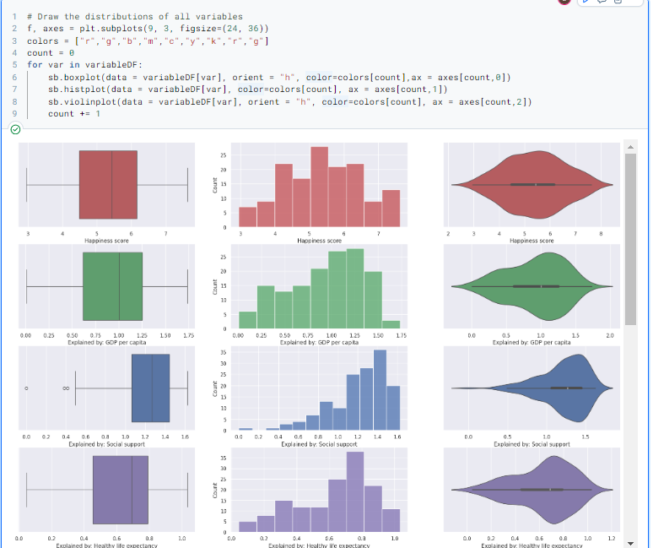
Univariate Visualization
Identifying patterns in the dataset using univariate
visualization through the use of box plots, violin plots, etc.
As seen from the plot diagrams and the skew function, we can see that most of the variables are negatively skewed

Slide 13
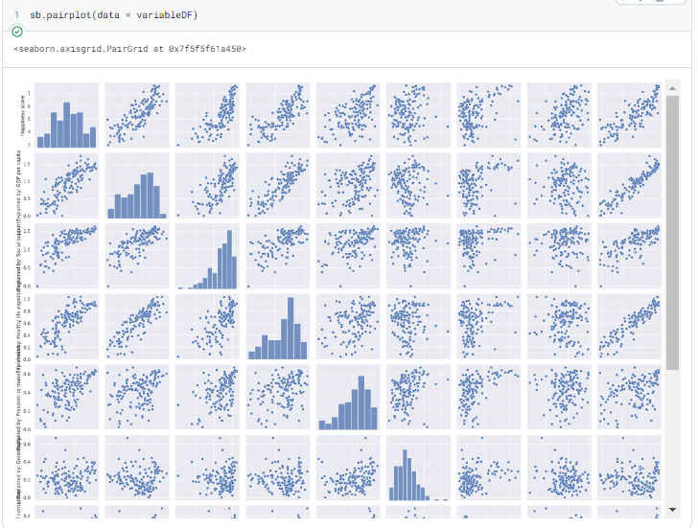
Multivariate Visualization
Plotting a pair plot to see the scatter plots of the different variables

Slide 14
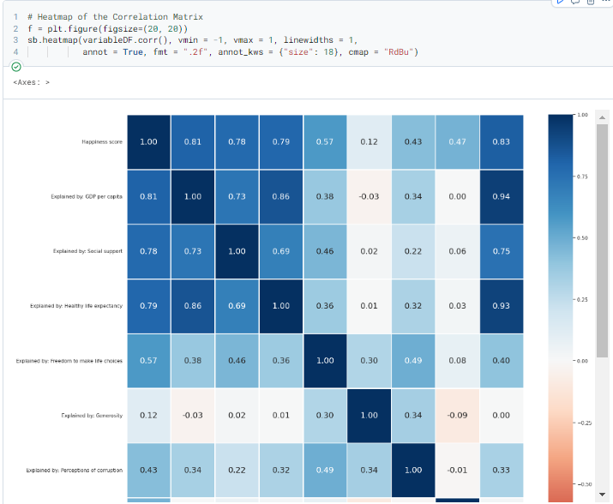
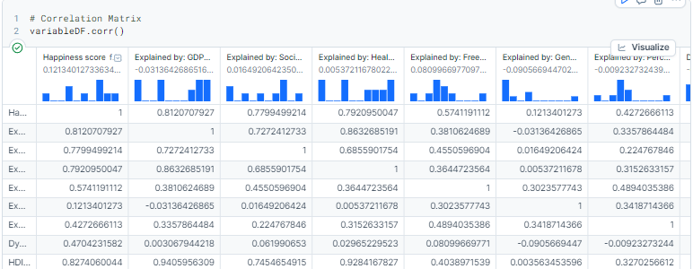
Multivariate Visualization
Plotting a correlation matrix, then plotting a heatmap with the correlation matrix

Slide 15
Multivariate Visualization
From our multivariate visualization, we gain numerous key insights:
Happiness score has relatively high correlations with:
GDP per capita
Social support
Healthy life expectancy
The 3 variables mentioned have a relatively high correlation with one another
'Dystopia + residual' has a near zero correlation
Logical Inference: HDI Value (Development of people) could be useful in predicting happiness score (More will be done in Machine Learning)

Slide 16

05
Machine Learning

Slide 17
Types of Machine Learning
Random Forest
Gradient Boosting
K-Means
|____________________________________________________________________|
Tree-Based Models
Supervised Learning
Clustering Model
Unsupervised Learning

Slide 18
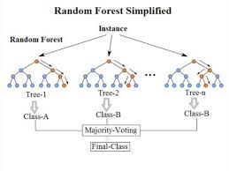
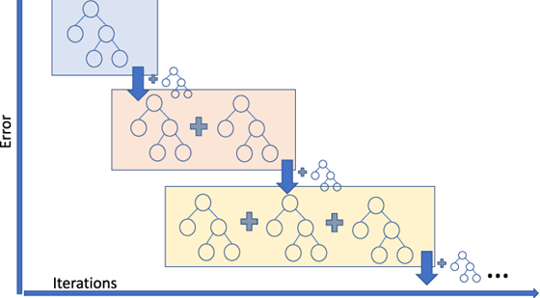
Tree-Based Models
Random Forest
Constructs a multitude of decision trees
Aggregates average of multiple
decision trees
Gradient Boosting
Constructs decision trees sequentially
Each resulting tree corrects the errors
of the prior

Slide 19
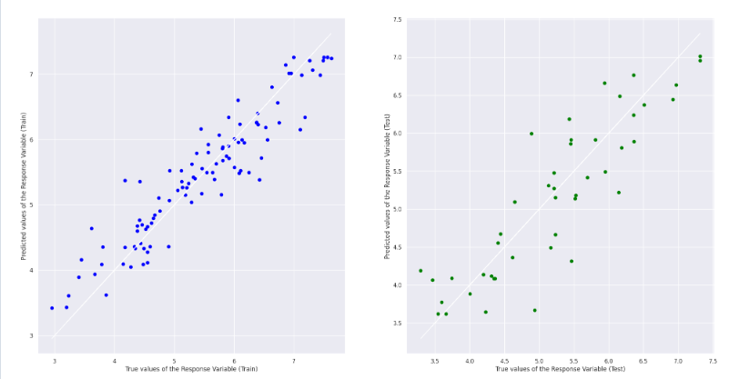
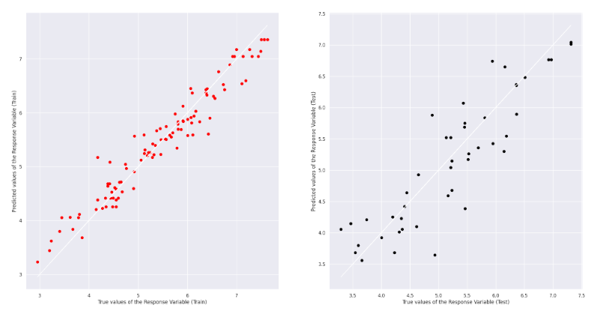

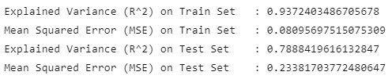
Random Forest VS Gradient Boosting
(Prediction of Happiness Score)

Slide 20
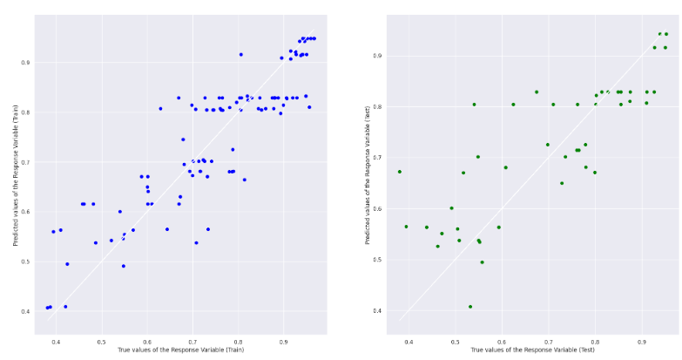
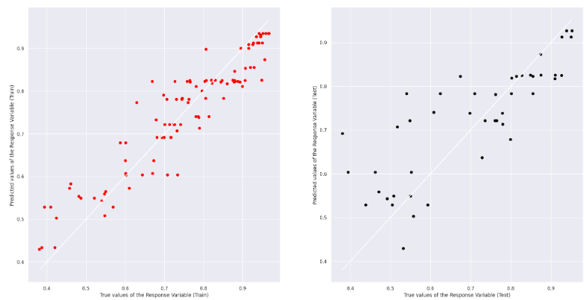


Random Forest VS Gradient Boosting
(Prediction of HDI)

Slide 21


Random Forest VS Gradient Boosting
(Feature Importance)
Random Forest
VS
Gradient Boosting
Key Feature: Social Support

Slide 22
Unsupervised Learning (K-Means)
Initialization: Select k initial centroids randomly or through other methods.
Assignment: Assign each data point to the nearest centroid.
Update: Recalculate centroids by averaging points in each cluster.
Iteration: Repeat assignment and update steps until centroids stabilize.
Convergence: Algorithm stops when clusters no longer change.
Output: Clusters are formed with centroids representing their centers.
Notes:
Initialization: We start by selecting 'k' centroids at random. These centroids serve as the initial centers of our clusters.
Assignment: Next, we assign each data point in our set to the nearest centroid. The proximity is typically measured by Euclidean distance, essentially finding the closest cluster center.
Update: Once all points are assigned, we update the position of each centroid. This is done by calculating the mean of all points in each cluster, hence refining the center of each cluster.
Iteration: We repeat the assignment and update steps. With each iteration, the centroids move until they find a stable position where they best represent the centers of their clusters.
Convergence: The algorithm stops when there's no significant change in the centroids' position or in the points assigned to each cluster, indicating that a stable grouping has been achieved.
Output: The result is a set of clearly defined clusters with centroids that indicate the typical characteristics of points within each cluster.
In essence, k-means helps us to identify groups within data, making it a fundamental tool for data analysis, especially in fields like market segmentation and pattern recognition."

Slide 23
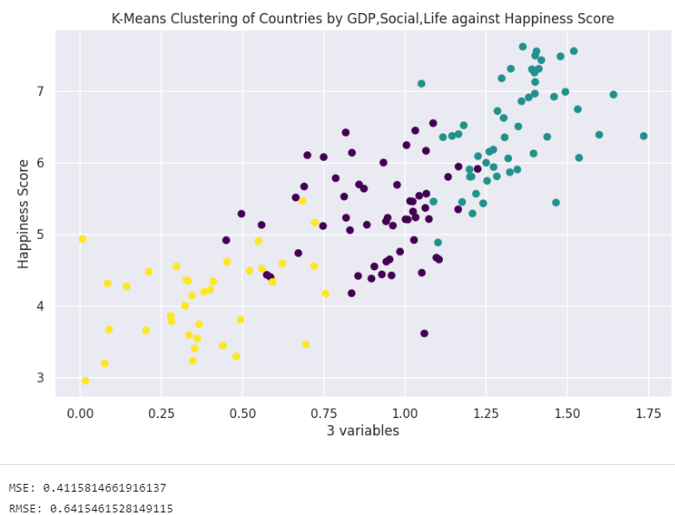
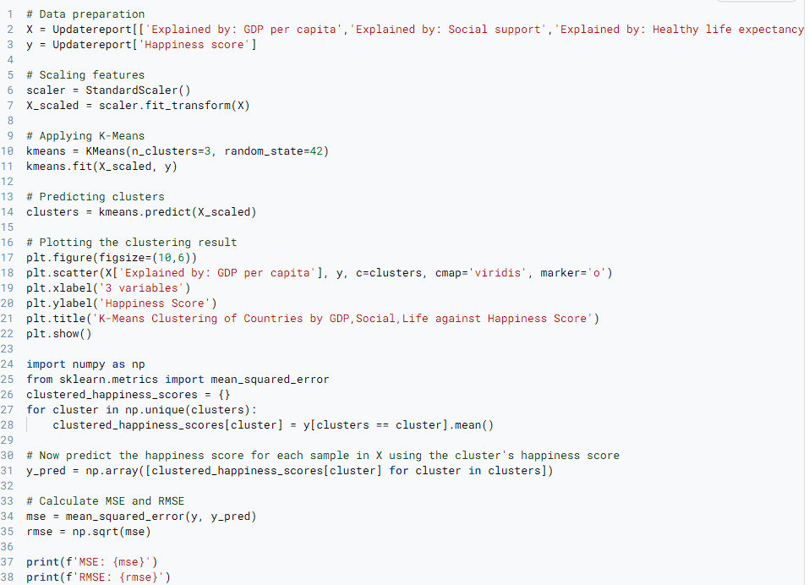
K-Means
Notes:
How we implemented K-Means into our project

Slide 24
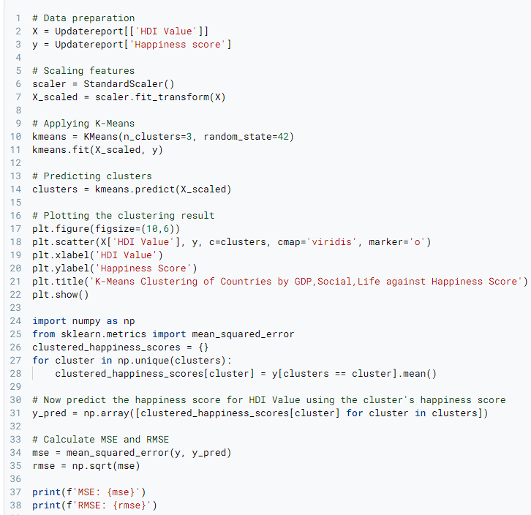
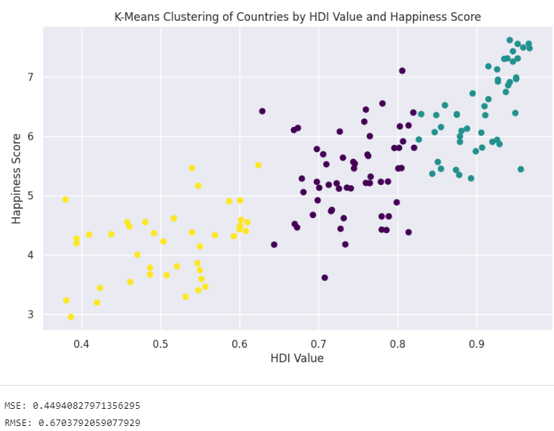
K-Means
Notes:
Both snippets calculate the mean Happiness Score for each cluster and then predict the Happiness Score for each sample based on its cluster's mean. They then compute MSE and RMSE to evaluate the prediction.
In summary, while the structure and purpose of both code snippets are similar, the main difference lies in the number of features used for clustering, which impacts the granularity and possibly the accuracy of the analysis

Slide 25
K-Means
Notes:
Cluster-Based Prediction of Happiness Scores:
The first snippet seems focused on exploring the relationship between a single dimension (HDI) and happiness, which might simplify the understanding but lacks the depth of multiple dimensions.
The second snippet, by incorporating multiple factors that might impact happiness, attempts a more comprehensive analysis. This can be more informative but also more complex to interpret correctly, especially when not all features are visualized clearly in the plot.

Slide 26
06
Conclusion & What did we learn

Slide 27
Conclusion
Key Correlations
Happiness Score strongly linked with GDP, Social Support, and Healthy Life Expectancy
Model Comparison
Gradient Boosting consistently outperformed Random Forest in terms of R^2 as well as MSE, demonstrating its efficacy in error correction and learning from weaker models
Key Feature
Social Support identified as the most important feature based on Random Forest and Gradient Boosting
Notes:
Happiness Score Correlations:
The Happiness Score is strongly correlated with GDP, Social Support, and Healthy Life Expectancy, indicating that economic and social factors are crucial determinants of well-being.
Model Performance:
In predictive accuracy, Gradient Boosting outperforms Random Forest, with better R^2 and lower MSE values. This suggests Gradient Boosting is more effective at learning from data and correcting errors.
Important Feature:
Social Support is highlighted as the most critical factor influencing Happiness Scores, as identified by both Random Forest and Gradient Boosting models.

Slide 28
What did we learn from this project?
ML Techniques: Applied supervised algorithms like Gradient Boosting and Random Forest, along with unsupervised K-Means Clustering.
Model Effectiveness: Demonstrated low MSE by predicting the Happiness Score from GDP, Social Support, and Life Expectancy.
Tool Utilization: Used scikit-learn for algorithm implementation and data processing tools.
Best Performer: Gradient Boosting outperformed Random Forest in predictive accuracy.
Team Collaboration: Enhanced teamwork and code sharing through GitHub.
Notes:
Machine Learning Techniques: Utilized both supervised (Gradient Boosting, Random Forest) and unsupervised (K-Means Clustering) machine learning algorithms to analyze data.
Predictive Accuracy: Achieved low Mean Squared Error (MSE) by using key predictors (GDP, Social Support, Healthy Life Expectancy) for the Happiness Score, indicating effective model performance.
Tools and Libraries: Employed scikit-learn for implementing algorithms such as RandomForestRegressor and GradientBoostingRegressor, and tools like Feature Importance and StandardScaler for data processing.
Model Comparison: Found Gradient Boosting to have superior predictive accuracy compared to Random Forest in terms of both fitting the model and error reduction.
Collaboration: Enhanced skills in team collaboration and code management using GitHub.

Slide 29
References
https://www.kaggle.com/datasets/unsdsn/world-happiness/data
https://worldhappiness.report
https://hdr.undp.org/data-center/human-development-index#/indicies/HDI
https://scikit-learn.org/stable/modules/generated/sklearn.ensemble.RandomForestRegressor.html
https://scikit-learn.org/stable/modules/generated/sklearn.ensemble.GradientBoostingRegressor.html
https://scikit-learn.org/stable/auto_examples/ensemble/plot_forest_importances.html

